Slide 1
Triangle Quest 2
Akhtamov Azimjon, 2024299010
10.11.2024

Slide 2

Problem Definition (1)
Source:
Title: Triangle Quest 2
Difficulty: Medium
Type: Math problem

Slide 3
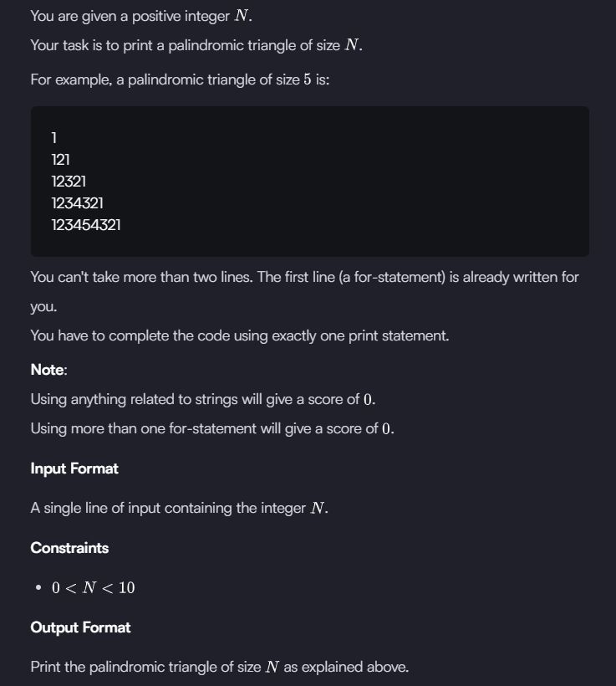
Problem Definition (2)

Slide 4
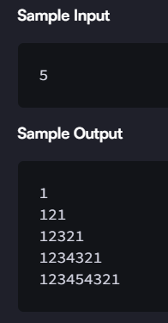
Problem Definition (3)

Slide 5
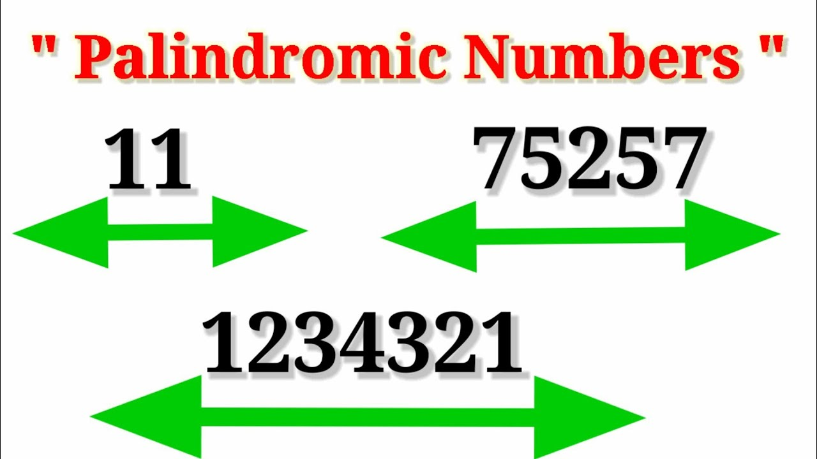
Solution (1)
Palindromic triangle we should draw by code on console!

Slide 6

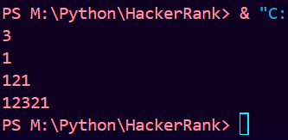

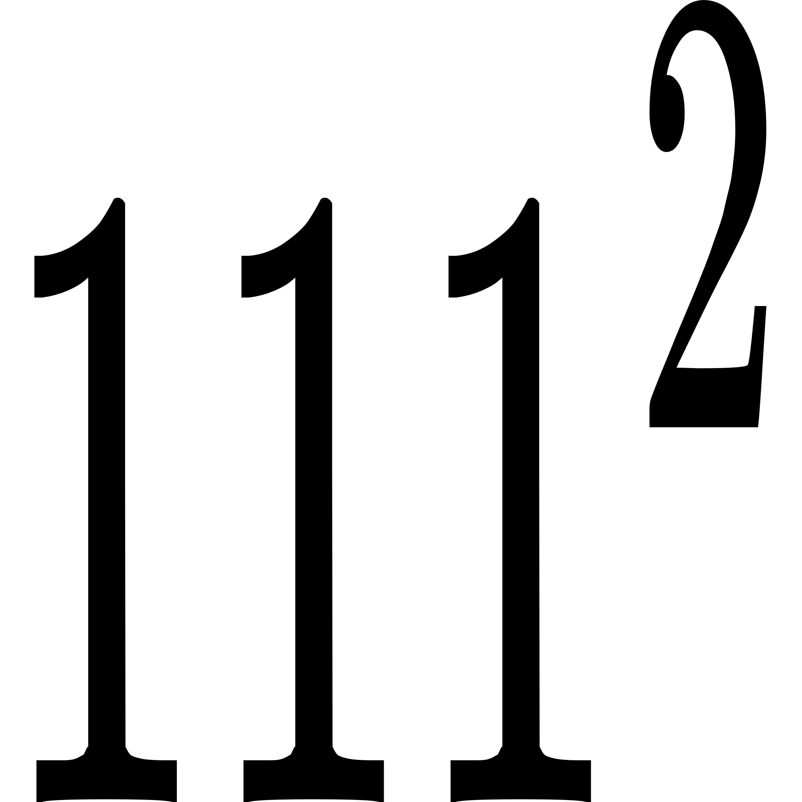
Solution (2)
N = 3

Slide 7
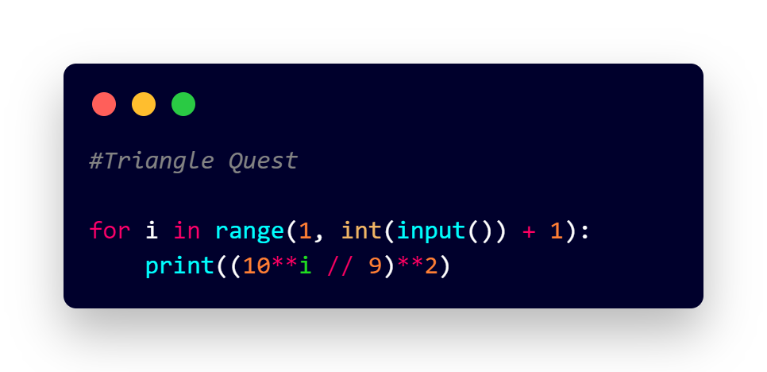
Solution (2)

Slide 8
What you have learned
How to getting palindromic numbers (1234321)

Slide 9
Questions and Answers

Slide 10
Greetings

